Slide 1
Introduction to Molecular Biophysics (2)
Protein data bank
VMD
Protein structure and disorder
MD simulation

Slide 2

Structural models
All models are wrong, but some are useful.
06/23/2019
www.rcsb.org
Most, if not all, structural models deposited in PDB are useful models
MD simulations of biomolecules usually start with a structure deposited in the PDB!
What can we learn from the PDB file?
Fasta sequence
(XYZ) Coordinates
Resolution
Atomic displacement parameter (ADP, or B-factor)
Occupancy
Structural Factors
Electron density
… …

Slide 3
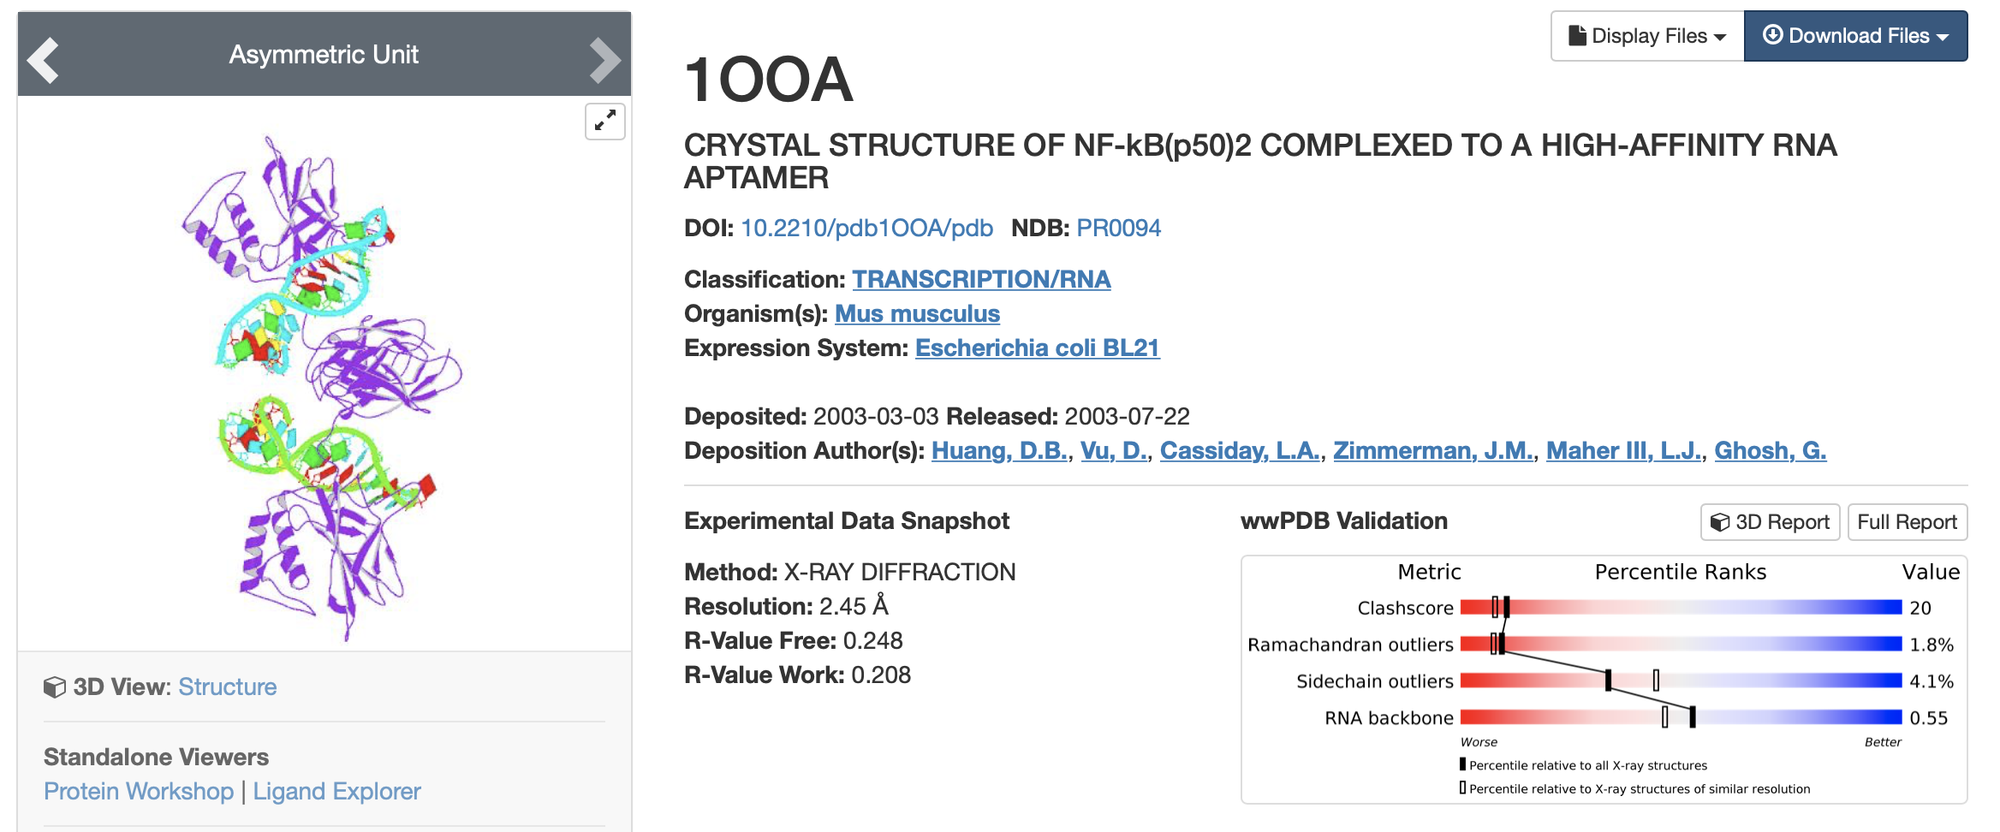
Go to www.rcsb.org, and search for a protein (entry “1ooa”)
# Let’s dig in the website and find more info #

Slide 4

1. Fasta sequences
>1OOA:A|PDBID|CHAIN|SEQUENCE GGPYLQILEQPKQRGFRFRYVCEGPSHGGLPGASSEKNKKSYPQVKICNYVGPAKVIVQLVTNGKNIHLHAHSLVGKHCE DGVCTVTAGPKDMVVGFANLGILHVTKKKVFETLEARMTEACIRGYNPGLLVHSDLAYLQAEGGGDRQLTDREKEIIRQA AVQQTKEMDLSVVRLMFTAFLPDSTGSFTRRLEPVVSDAIYDSKAPNASNLKIVRMDRTAGCVTGGEEIYLLCDKVQKDD IQIRFYEEEENGGVWEGFGDFSPTDVHRQFAIVFKTPKYKDVNITKPASVFVQLRRKSDLETSEPKPFLYYPEIKDKEEV QRKRQK
Note that in proteomes, an ORF usually starts with “M” and ends with “*”
First line is the annotations starting with a ”great-than” symbol
2. Coordinates
1 2 3 4 5 6 7 8
12345678901234567890123456789012345678901234567890123456789012345678901234567890
MODEL 1
ATOM 1 O5' C C 1 2.795 -15.317 21.874 1.00128.97 O
ATOM 2 C5' C C 1 3.850 -15.047 22.799 1.00134.17 C
… …
TER 6152 GLU B 350
HETATM 6153 O HOH C 408 15.555 -31.413 8.111 1.00 27.47 O
… …
x
y
z

Slide 5
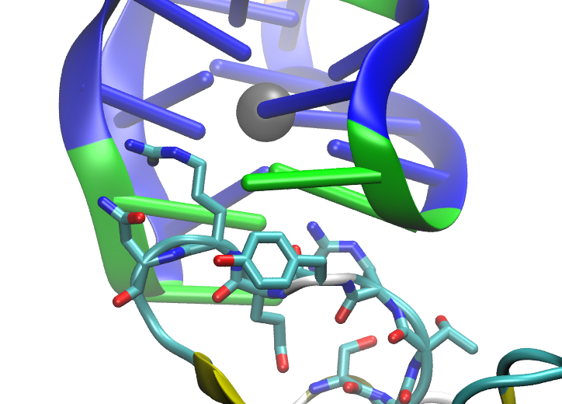
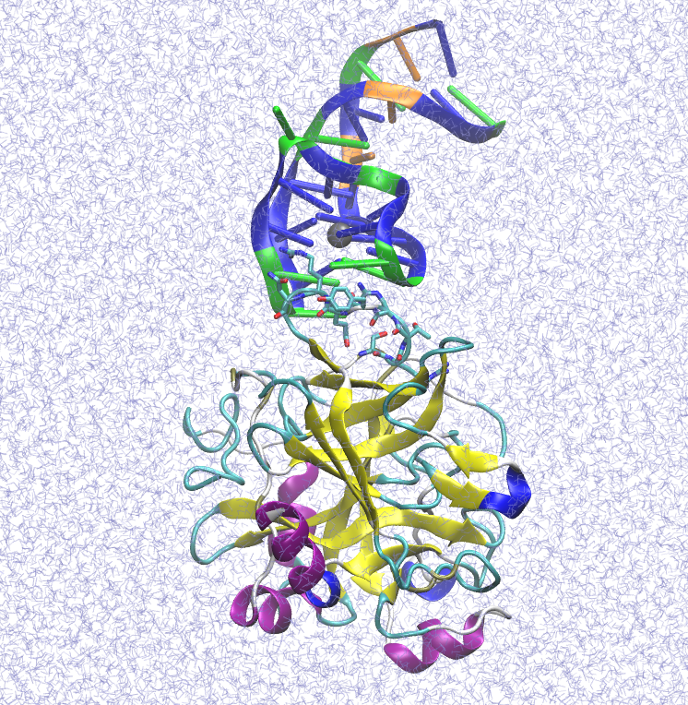
VMD (visual molecular dynamics) is designed for modeling, visualization, and analysis of biological systems such as proteins, nucleic acids, lipid bilayer assemblies, etc. It may be used to view more general molecules, as VMD can read standard Protein Data Bank (PDB) files and display the contained structure. VMD provides a wide variety of methods for rendering and coloring a molecule: simple points and lines, CPK spheres and cylinders, licorice bonds, backbone tubes and ribbons, cartoon drawings, and others. VMD can be used to animate and analyze the trajectory of a molecular dynamics (MD) simulation. In particular, VMD can act as a graphical front end for an external MD program by displaying and animating a molecule undergoing simulation on a remote computer.
We will use VMD:
Visualize biomolecular structures
Construct models for MD simulations
Analyze MD trajectories
Create structural figures (for publications, proposals etc)
And more

Slide 6
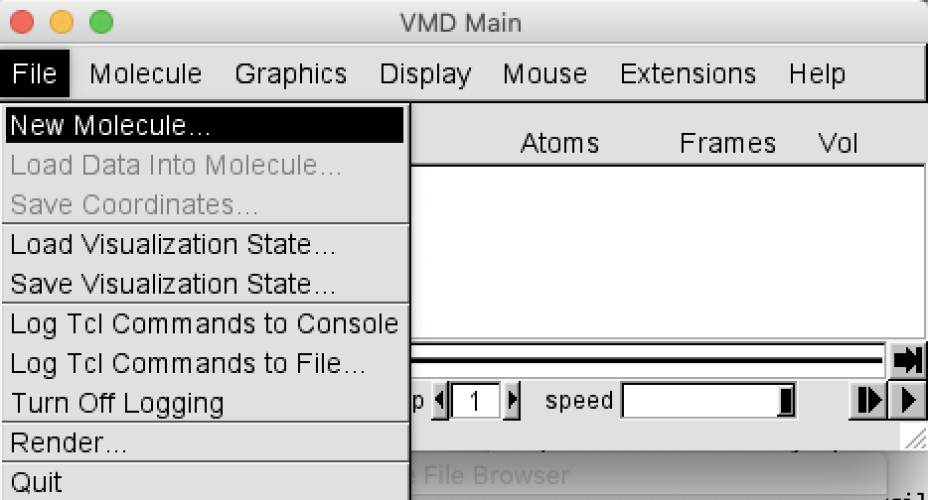
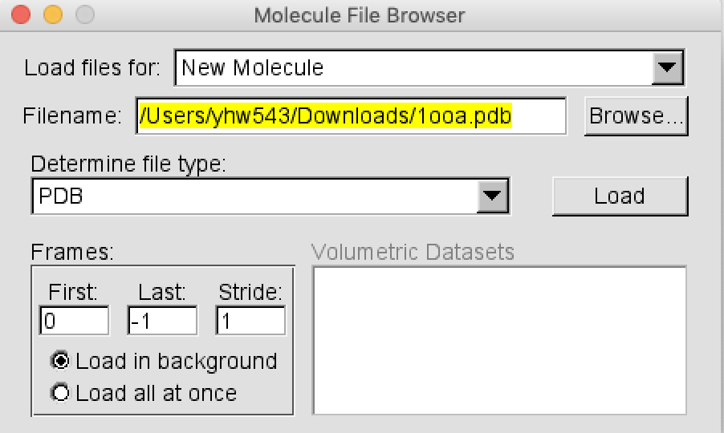
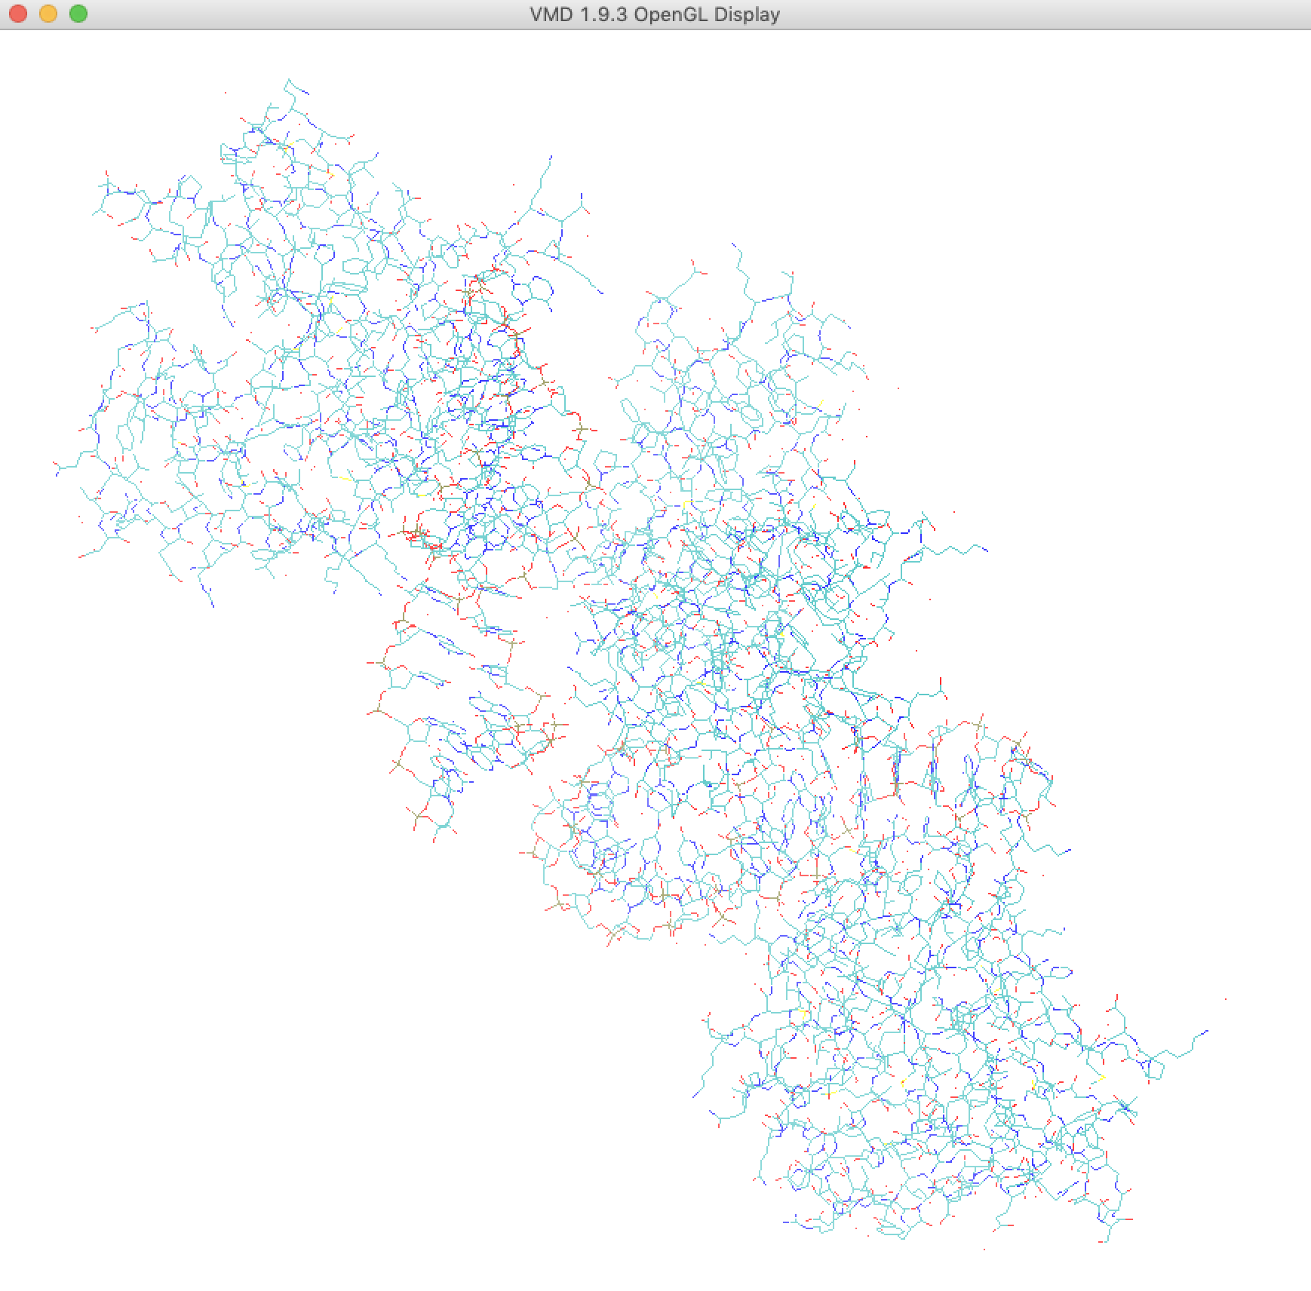
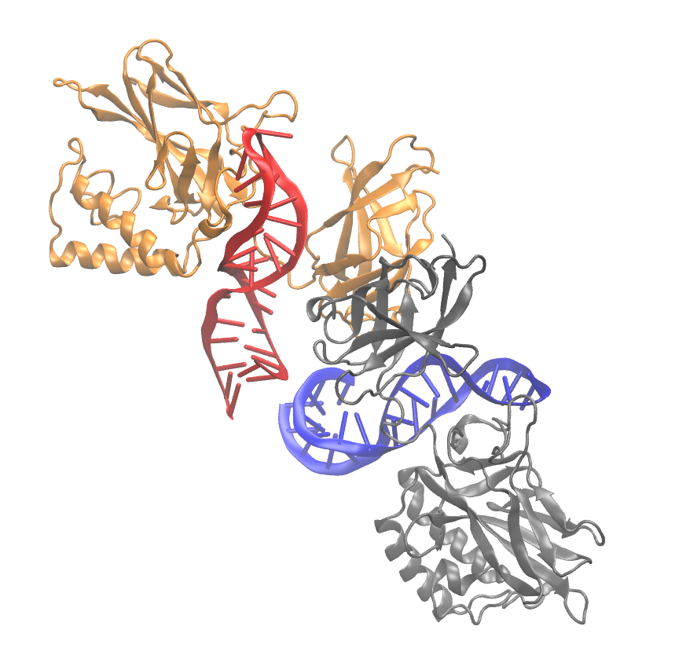
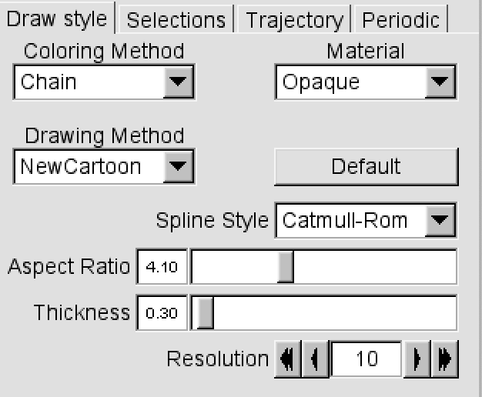
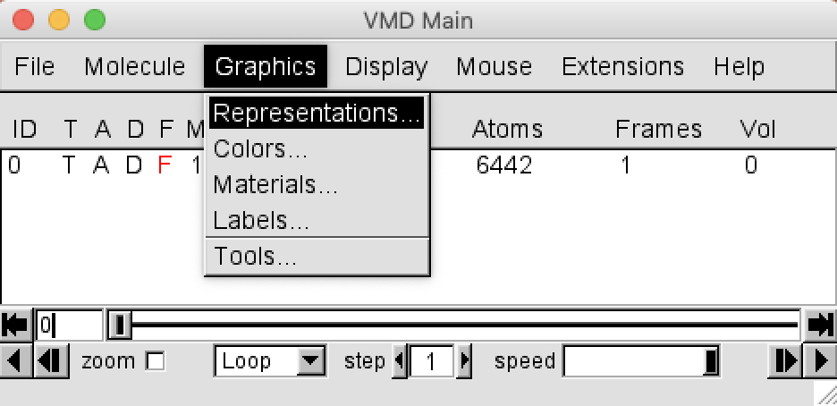
Visualizing a protein structure

Slide 7
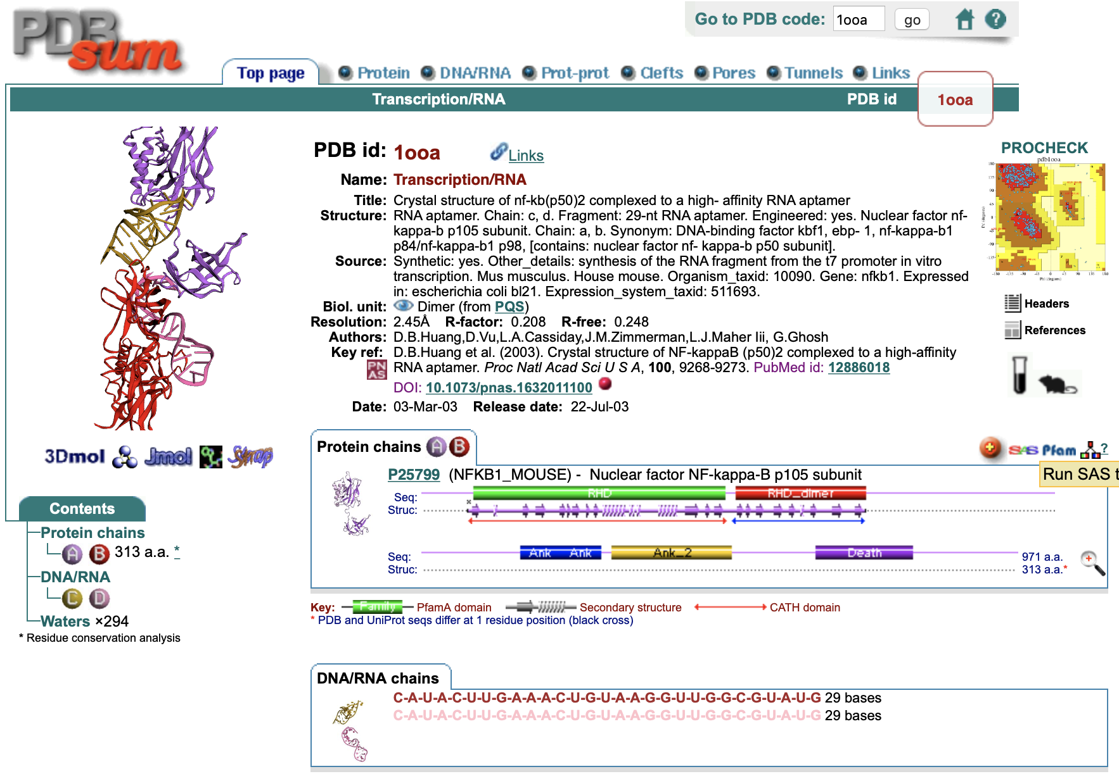
http://www.ebi.ac.uk/pdbsum/

Slide 8
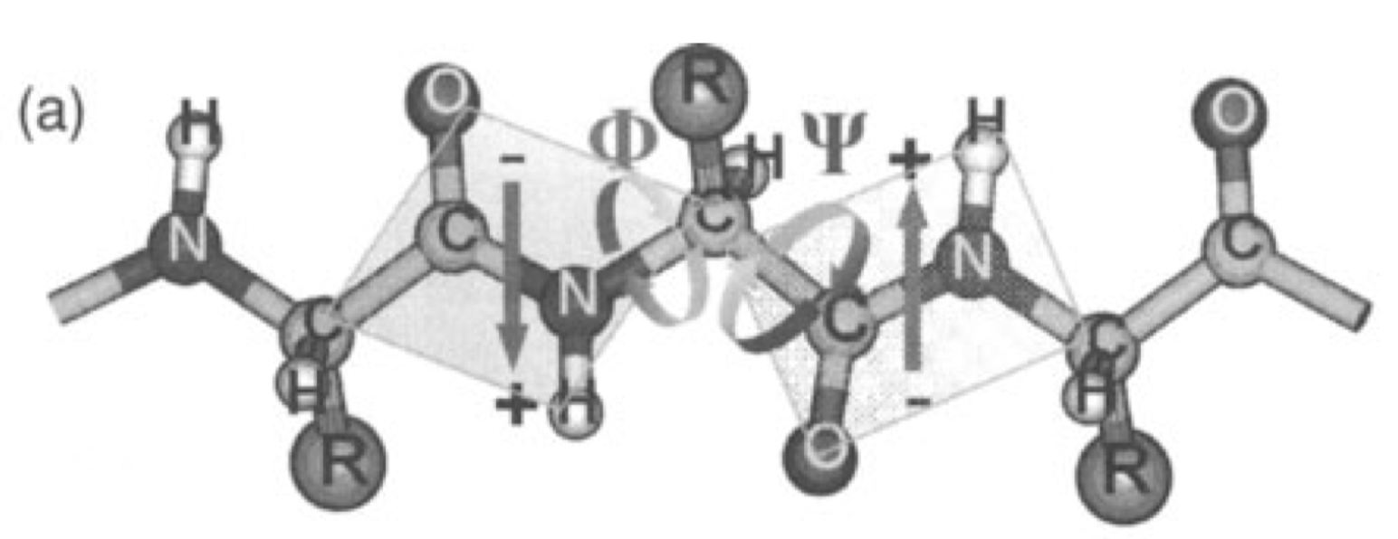
Secondary structure, Ramachandran plot
Secondary structure (top) and domains of 1ooaA (1D)
Ramachandran plot of 1ooaA
Most favoured regions [A,B,L] 458
Additional allowed regions [a,b,l,p] 74
Generously allowed regions [~a,~b,~l,~p] 4
Disallowed regions [XX] 0
Guo 2007

Slide 9
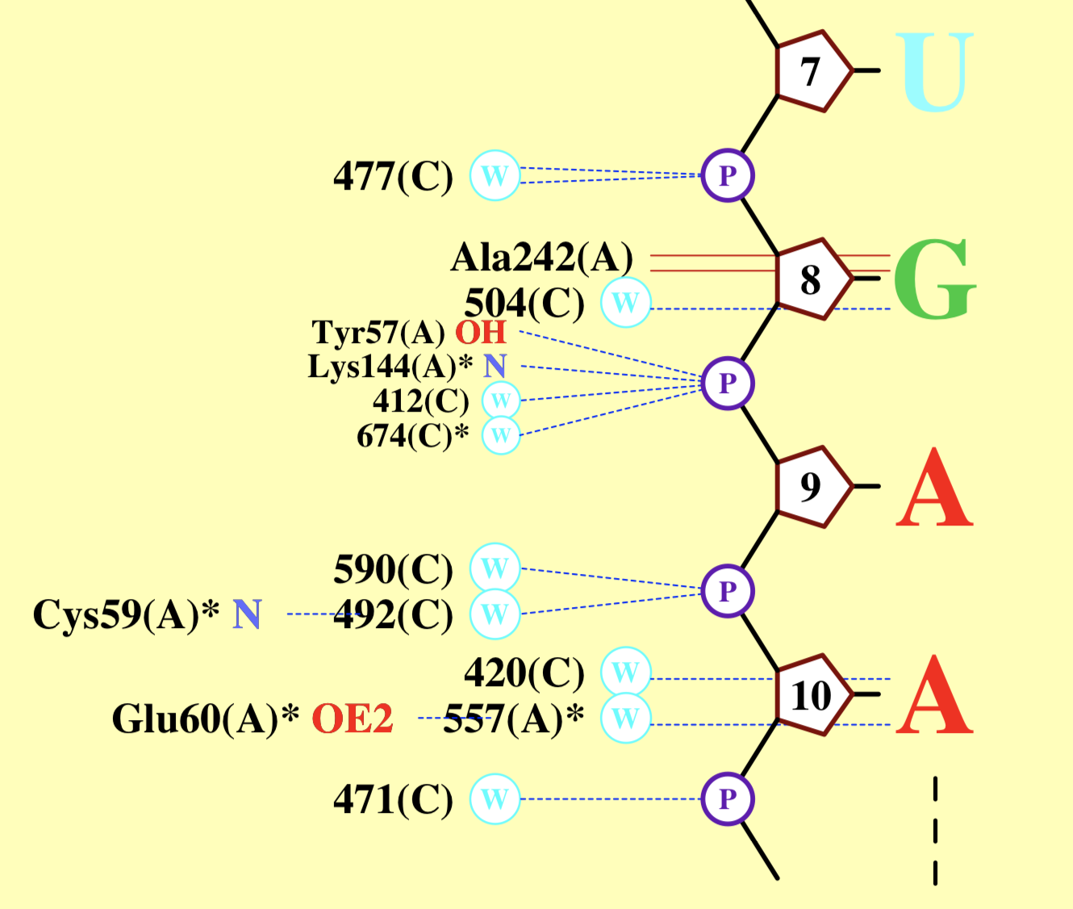
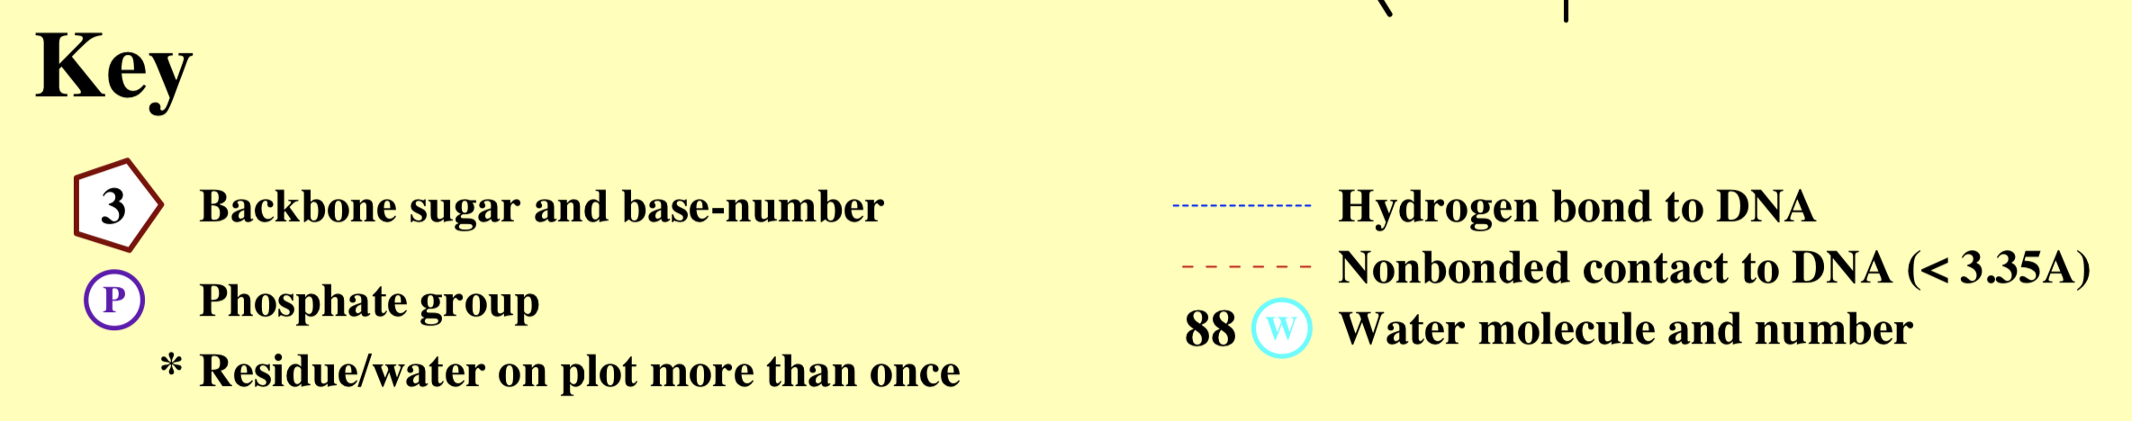
Protein-RNA (DNA) interactions

Slide 10
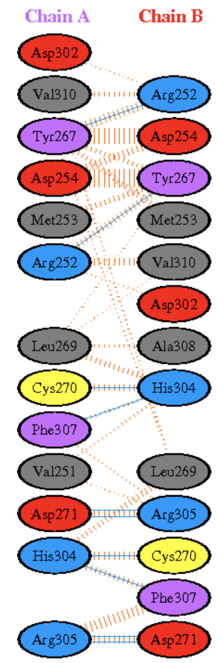
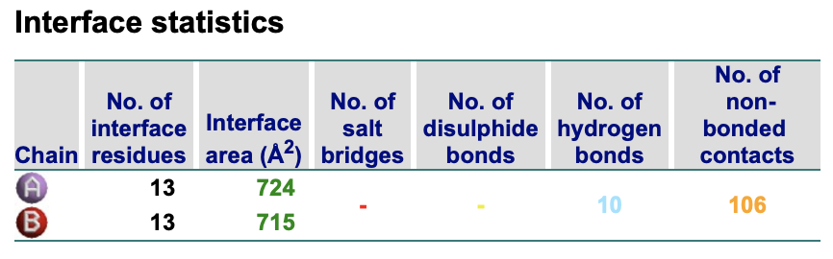
Protein-protein interactions (PPIs)
Hydrogen bonds
--------------
<----- A T O M 1 -----> <----- A T O M 2 ----->
Atom Atom Res Res Atom Atom Res Res
no. name name no. Chain no. name name no. Chain Distance
1. 2889 NE ARG 252 A <--> 5459 OH TYR 267 B 3.31
2. 3001 OH TYR 267 A <--> 5349 NH1 ARG 252 B 2.97
3. 3021 O CYS 270 A <--> 5763 NE2 HIS 304 B 2.87
4. 3030 OD1 ASP 271 A <--> 5771 NE ARG 305 B 3.33
5. 3030 OD1 ASP 271 A <--> 5774 NH2 ARG 305 B 2.85
6. 3305 NE2 HIS 304 A <--> 5479 O CYS 270 B 2.88
7. 3305 NE2 HIS 304 A <--> 5787 O PHE 307 B 2.82
8. 3313 NE ARG 305 A <--> 5488 OD1 ASP 271 B 3.28
9. 3316 NH2 ARG 305 A <--> 5488 OD1 ASP 271 B 2.71
10. 3329 O PHE 307 A <--> 5763 NE2 HIS 304 B 3.05

Slide 11
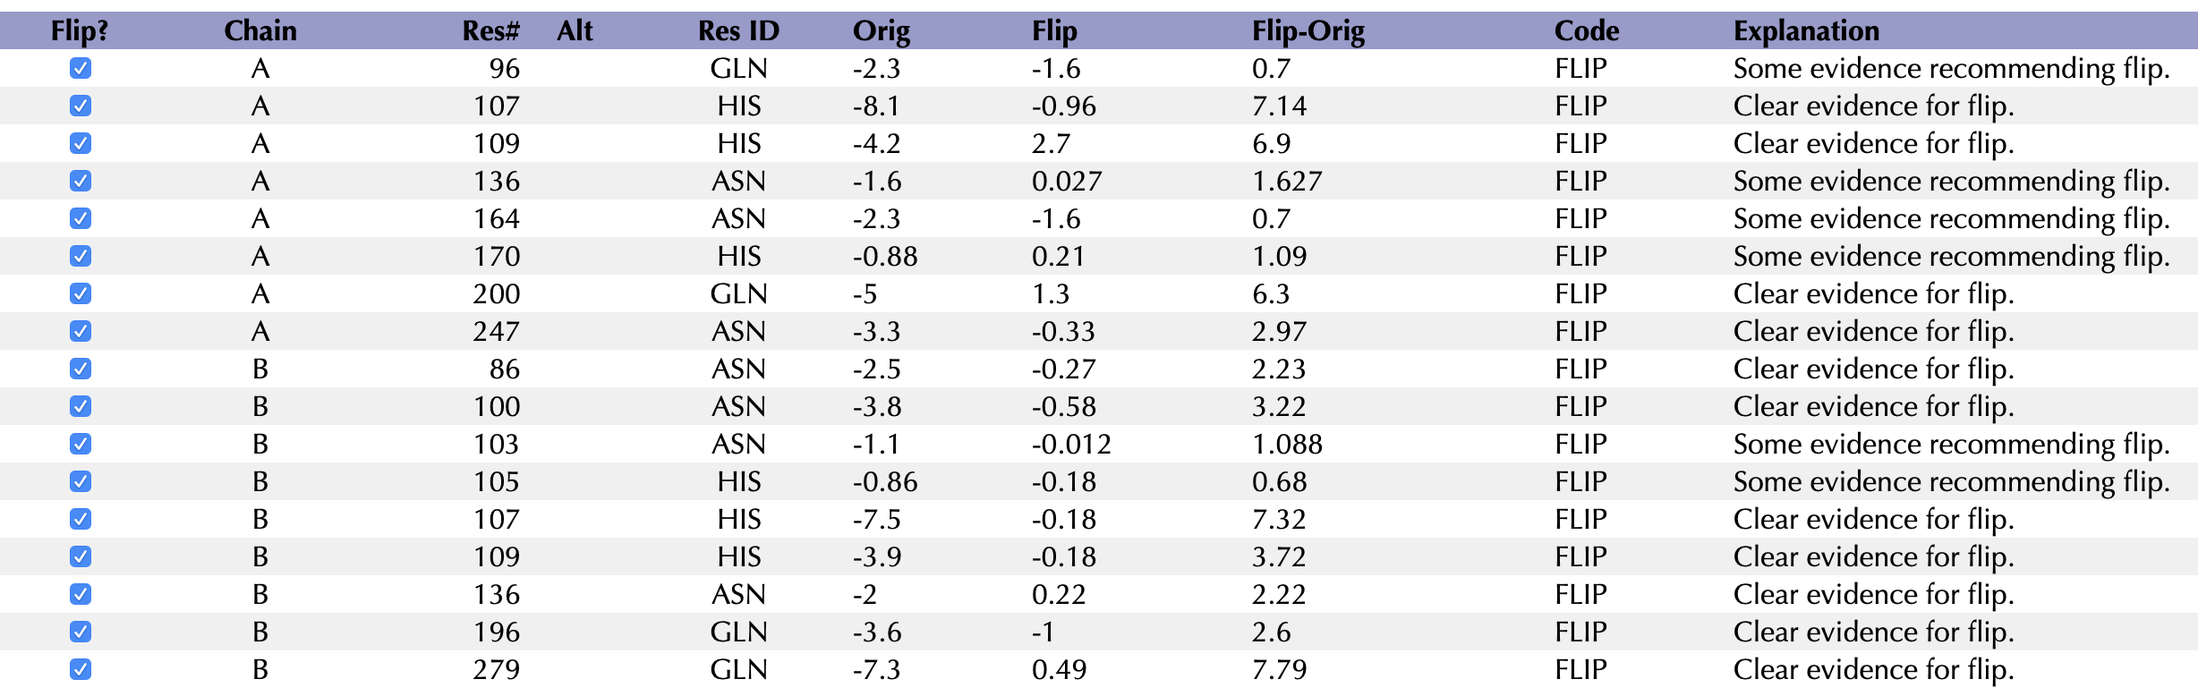
Protein quality check
http://molprobity.biochem.duke.edu
Correct side-chain rotations (rotamers) of residues, esp. Gln, Asn, His:
1ooaF.pdb; 1ooaFH.pdb

Slide 12
0
A structure without a function is a corpse; a function without a structure is a ghost…?
A structure without dynamics is a corpse; a function arises from structural dynamics and interactions
--- the primary goal of MD simulations is to understand the functions from structural dynamics and interactions.
Disorder contents (D)
Intrinsically disordered proteins (IDPs) are observed in all organisms! Many of them play vital roles in the cells.
Protein disorder predictors are all around --- 60+ so far.
1
V. N. Uversky, 2016

Slide 13
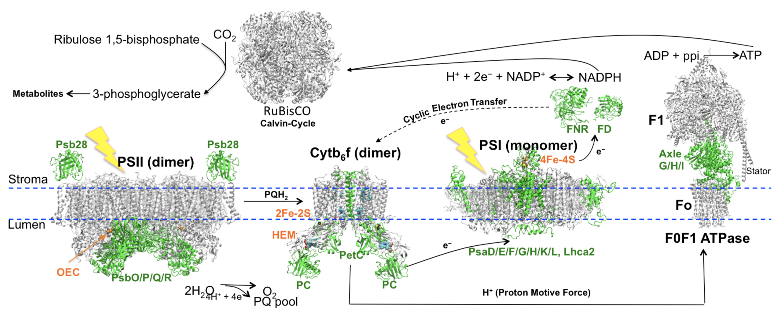
A personal perspective (on protein disorder)
Structural modeling: structural models of the four photosynthetic machineries in Agave americana constructed from the protein sequences solved by RNA- seq. including photosystem I/II (PSI/II), cytochrome b6f complex (Cytb6f), and FoF1 ATP synthase (FoF1 ATPase). Structural models of important proteins expressed in the dark (green) in these complexes indicate they are located at the peripheral regions of the complexes and play roles in electron transfers. Guo et al. the 34th New Phytologist Symposium, 2014.

Slide 14
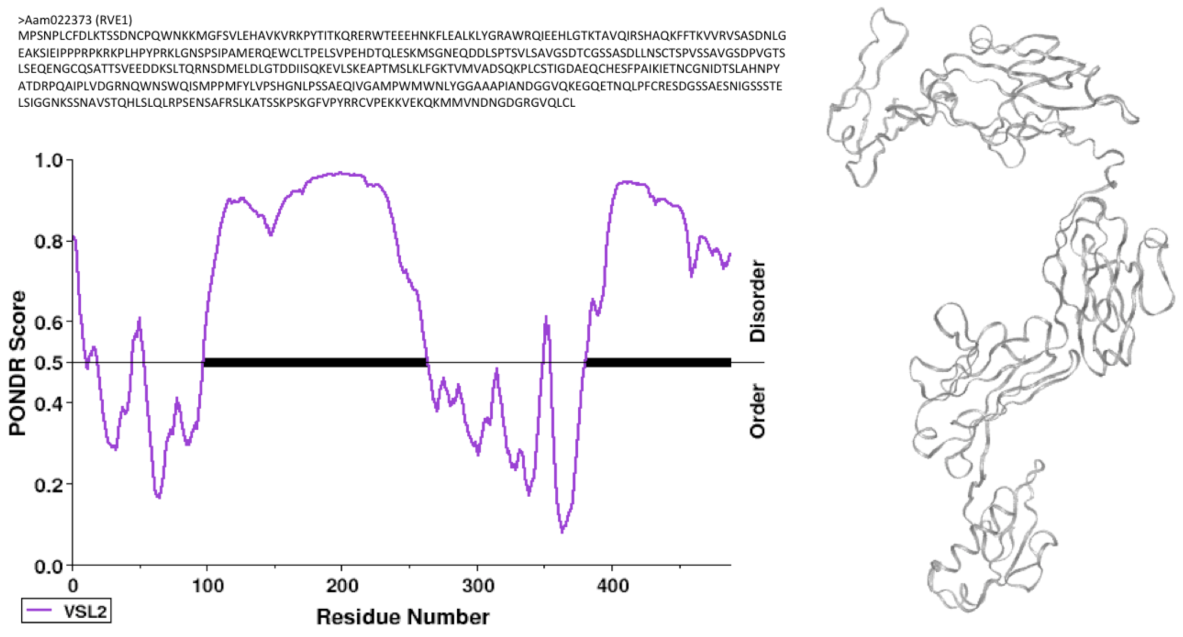
An IDP: sequence (left top), residual intrinsic disorder (ID) contents (left bottom) and a structural model (right) of the RVE1 gene Aam022373 from A. americana (Yin & Guo et al. 2018). The black bars in the profile represents the ID regions.

Slide 15
Our solution: H (entropy) is additive, whereas d (disorder content) is not.
Guo et al. Int. J. Genomics, 2018;
Guo et al. Entropy 2019.

Slide 16
Interpreting functions from MD simulations
Hg(II)-MerR: Low resolution SAXS envelope shape
Guo et al. J. Mol. Biol. 2010

Slide 17
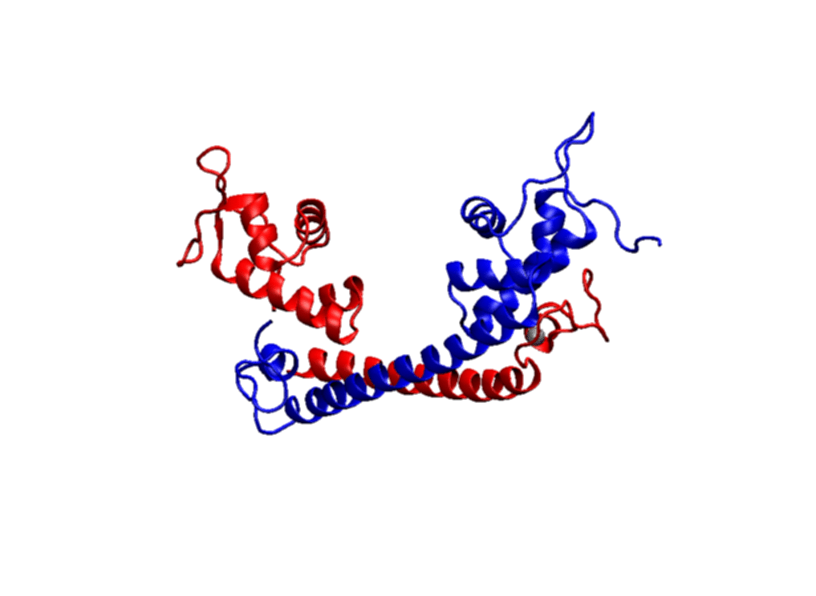
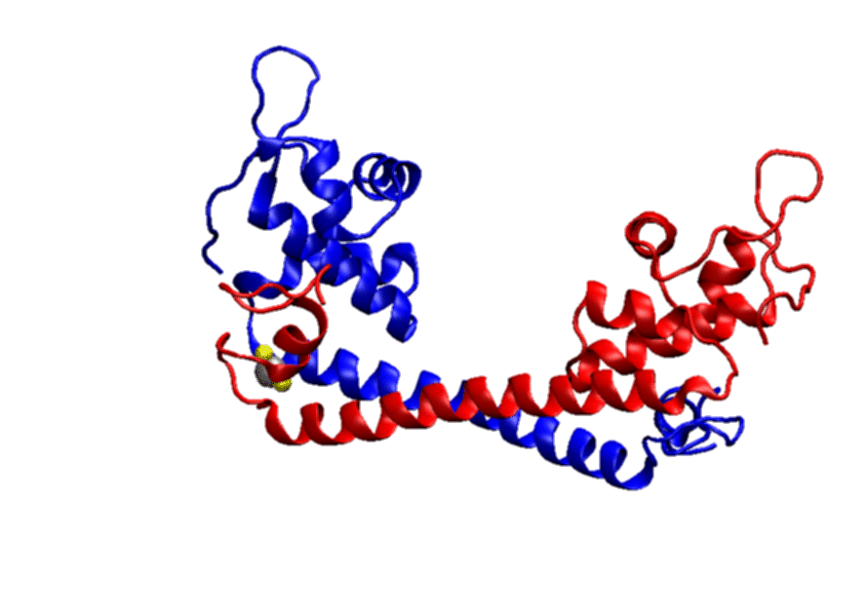
MD trajectory
Principle movement

Slide 18
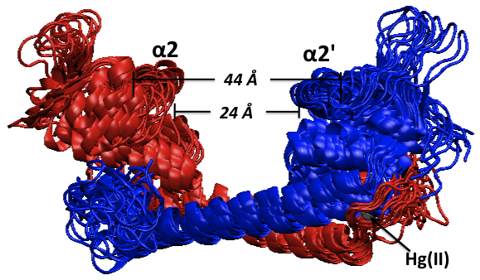
An ensemble of Hg(II)-MerR structures taken from MD trajectory. Two MerR chains are colored in red and blue, and Hg(II) in silver. The extreme distances between two DNA recognition helices (α2/α2’) are labeled.

Slide 19
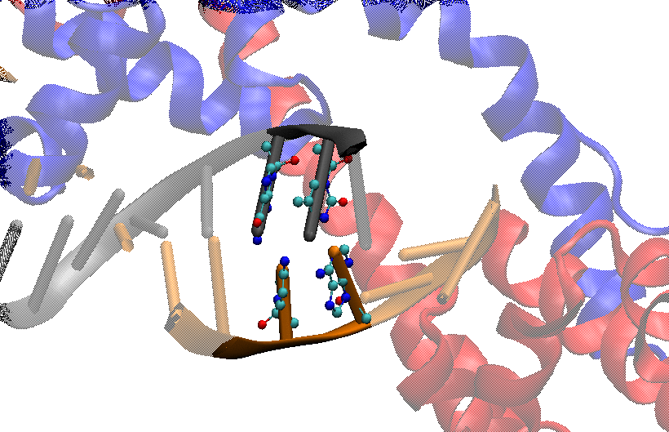
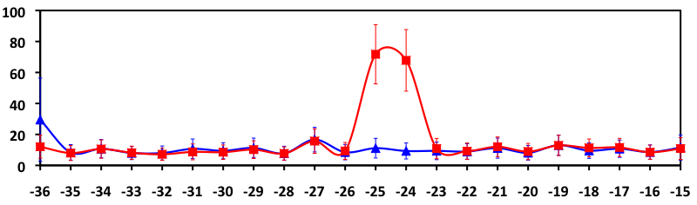
MerR Distorts Central BPs
Blue: DNA only
Red: MerR-DNA
Roll-Tilt Γ (°)
5'-G A C T C C G T A C A T G A G T A C G G A A G-3'
3'-C T G A G G C A T G T A C T C A T G C C T T C-5'
Roll-Tilt, Γ = (ρ² + τ²)^{1/2}

Slide 20
Summary
VMD (visual molecular dynamics) is a useful tool to visualize molecular structures, analyze molecular dynamics simulation trajectories and generate structural pictures or movies
Protein (intrinsic) disorder persist in all sequenced organisms and the intrinsically disordered proteins often play essential roles in the cell
To understand functions, we need to understand structural dynamics and interactions

Slide 21
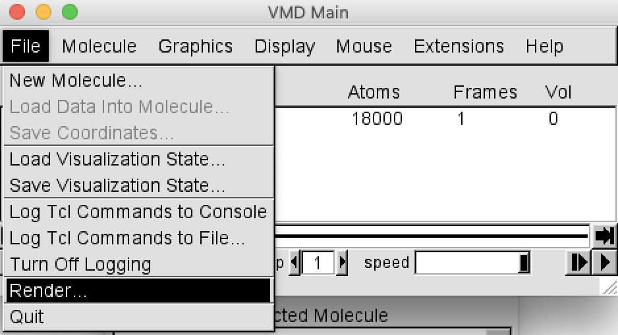
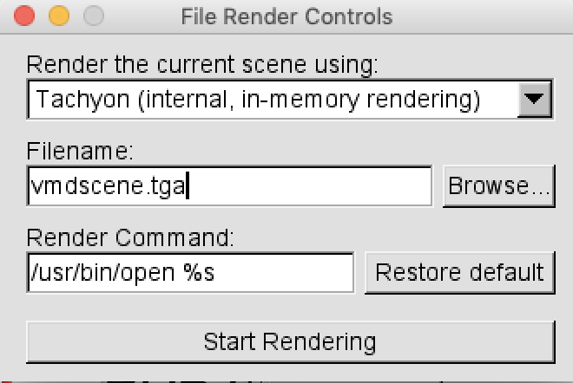
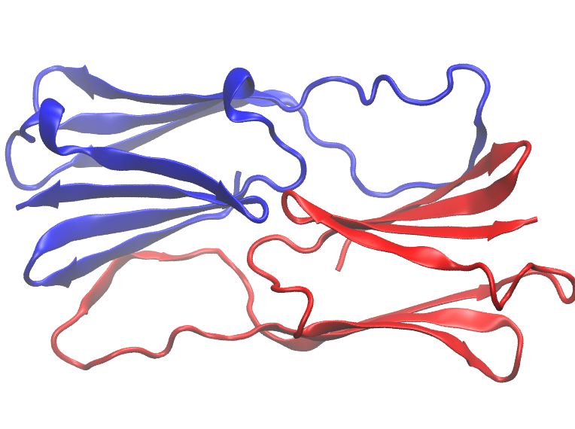
Homework
Visualize the structure of HSP26, PDB code: 2H50 --- this small heat-shock protein forms a dimer, then the dimer further forms multimers:
Use PDBsum to analyze the Ramachandran plot of this protein
Plot one of the dimer (hint: chain A and B) using VMD

